Slide 1
Welcome to
Total Quality Management
(19MEE347)
Unit 3 – Quality Loss Function
Name: Dr. Sunil Kumar
Department of Mechanical Engineering

Slide 2
Background of the Taguchi Method
Introduced by Dr. Genichi Taguchi (1980)
• Unique aspects of the Taguchi method
– The Taguchi definition of quality
– The Taguchi Quality Loss Function (QLF)
  – The concept of Robust Design
• Combines cost, target and variation
• Specification is of secondary importance
• Noise factors – uncontrollable variables that can cause significant variability in the process or the product

Slide 3
Quality Definition
Quality – loss imparted to the society from the time the product is shipped
Societal loss
  • Failure to meet customers requirements
  • Failure to meet ideal performances
  • Harmful side effects
  • Losses due to production (raw material, energy, labor) of unusable products or toxic by-products

Slide 4
Sony USA & JAPAN
* Customers preferred the televisions sets produced by Sony-Japan over those produced by Sony-USA.
* The color density of the televisions manufactured by Sony-USA were uniformly distributed and fell within the tolerance limits, m ± 5
• The televisions from Sony-Japan followed a normal distribution, more televisions were on target but about 0.3% fell outside of the tolerance limits.
• The differences in customer perceptions of quality resulted from Sony-USA paying attention only to meeting the tolerances whereas in Sony-Japan, the focus was on meeting the target and minimizing the variance around that target.

Slide 5
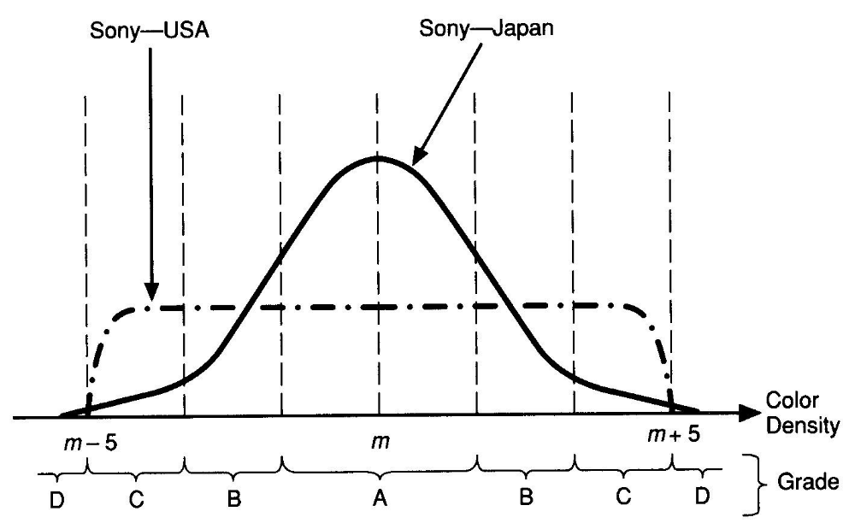
Sony USA & JAPAN

Slide 6
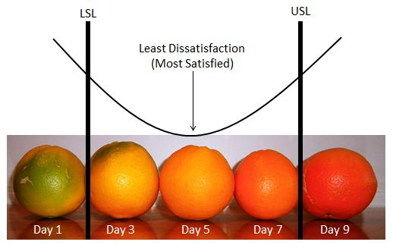
Taguchi Loss Function (TLF) – Nominal-the-best
“TLF is a graphical representation of how an increase in variation within specification limits leads to an exponential increase in customer dissatisfaction.”
Taguchi’s loss function explains the economic value of reducing variation in manufacturing.
L(y) = k(y – T)²
where:
L(y) is the cost involved as quality deviates from the target, T;
y is the performance characteristic;
k is a constant that translates the deviation into cost (quality loss coefficient)

Slide 7
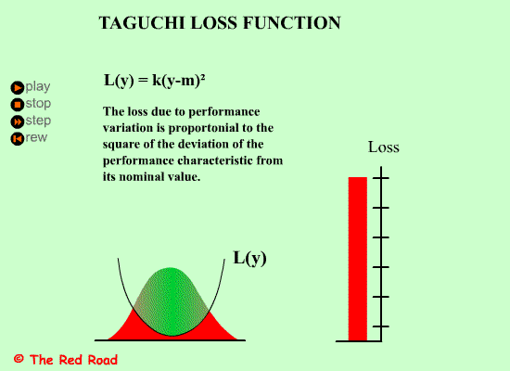
Taguchi Loss Function

Slide 8
Average Loss
Loss function must reflect the variation of many pieces rather than just one piece
L1 = k[σ² + (y1 - T)²]
σ is the population standard deviation

Slide 9
Taguchi Robust Design
• A process has “several” quality characteristics
  – Desirable Qualities
  Larger-the-Better (strength, mileage etc)
  Nominal-the-Best (specified dimensions, uniformity)
  – Undesirable properties
  Smaller-the-better (defects, resources - material/time, cost)
• Determine the best settings such that
  – Desirable qualities are enhanced
  – Undesirable properties are minimized/eliminated
      Process becomes ROBUST i.e. insensitive to Noise

Slide 10
Taguchi Design of Experiments
The Taguchi method is a structured approach for determining the ”best” combination of inputs to produce a product or service
DOE is an important tool for designing processes and products
– A method for quantitatively identifying the right inputs and parameter levels for making a high quality product or service

Slide 11
Robust Design
• NOISE - events that cause the design performance to deviate from its target values
• Taguchi divide NOISE into three categories
  – External Noise: variations in the environment where the product is used
  – Deterioration Noise: wear and tear inside a specific unit
  – Internal Noise: deviation from target values

Slide 12
NOISE
External Noise | Consumer’s Usage condition Temperature Change Vibration Humidity
Deterioration Noise | Deterioration of parts Deterioration of material Oxidation (rust)
Unit to unit Internal Noise | Piece to piece vibration

Slide 13
Robust Design
• A three step method for achieving robust design (Taguchi)
  1. Concept design
  2. Parameter design
  3. Tolerance design
• The focus of Taguchi is on Parameter design

Slide 14
Robust Design
1.Concept Design
– The process of examining competing technologies for producing a product - Includes choices of technology and process design
– A prototype design that can be produced and meets customers’ needs under ideal conditions without disturbances

Slide 15
Robust Design
2. Parameter Design
– The selection of control factors (parameters) and their “optimal” levels
▪ The objective is to make the design Robust!
– Control factors are those process variables management can influence.
    ▪ Ex. the procedures used and the type and amount of training
    ▪ Often a complex (non-linear) relationship between the control factors and product/design performance
– The ”optimal” parameter levels can be determined through experimentation

Slide 16
Robust Design
3. Tolerance Design
– Development of specification limits
    ▪ Necessary because there will always be some variation in the production process
    ▪ Taguchi fiercely advocates aiming for the target value not just settle for “inside the specification limits”!
– Occurs after the parameter design
– Often results in increased production costs
▪ More expensive input material might have to be used to meet specifications

Slide 17
Problem
Suppose that the specification on a part is 0.500 ± 0.020 cm. A detailed analysis of product returns and repairs has discovered that many failures occur when the actual dimension is near the extreme of the tolerance range (that is, when the dimensions are approximately 0.48 or 0.52) and costs $50 for repair.
The deviation from the target, y – T , is 0.02 and L(y) = $50.
Substituting these values, we have:
      50 = k(0.02)²
      or
      k = 50/0.0004 = 125,000
Therefore, the loss function for a single part is L(y) = 125000(y – T)²
when the deviation is 0.10, average loss per unit is:
L(0.10) = 125,000(0.10)² = $12.50 per part

Slide 18
Problem
Knowing the Taguchi loss function helps designers to determine appropriate tolerances economically. For example, suppose that a simple adjustment can be made at the factory for only $2 to get this dimension very close to the target.
If we set L(x) = $2 and solve for x – T, we get:
  2 = 125000(x – T)²
  x – T = 0.004
Therefore, if the dimension is more than 0.004 away from the target, it is more economical to adjust it at the factory and the specifications should be set as 0.500 ± 0.004.

Slide 19
THANK YOU!!!

